Slide 1
SAP Business Workflow

Slide 2
Topics for today’s session:
Workflow Workflow Builder Task Workitem Agent Container Binding Business Object Builder Object Type Workflow Project Approach Workflow Components Workflow Architecture | Standard Task Creation Main 5 Question when we start with a workflow Step Types Types of Container Binding Workitem Different types of workitem Workitem Status Deadline monitoring Events Monitoring and Analysis Workflow Log Major Tcodes

Slide 3
What is Workflow?
A workflow consists of a sequence of steps, which are processed either by people or automatically by the system.
A mechanism that automates business processes.

Slide 4
Workflow is a tool that automates business processes in a flexible and transparent way and maps the individual tasks to the users. Push technology informs and helps the users through the process. Steps which do not require user intervention are carried out automatically, along with business logic and escalation procedures.
Ensures adherence to that process
Transparency of users and process
Process data available at your finger tips
Reporting exposes bottlenecks and inefficiencies
Ensures adherence to that process because workflow definition of that process is in the system. The workflow pushes that work right to the users. It does not (usually) require the users to move it to the next stage (throw out those in-trays!). No need to get up from your desk and walk over a piece of paper to someone's in-tray.
Using the log, workflow stores who executes what action (e.g. approval) as well as other data such as date/time etc. Each business process that is a workflow is now measurable and measurements can be derived for how long it takes to complete a particular business process. E.g. Leave request approval, customer complaint, etc
Data is pushed straight to the users screen via the use of attachments. E.g. a request for leave can appear in a manager’s inbox. Attached with it could be the employee record (along with previous leave requests etc). The manager does not need to search for this information. It is all a single mouse click away.
Using deadline monitoring, workflow can expose bottlenecks. Which employee is overworked, has slow turn-around of work, etc. furthermore, we can recognize which workers have some slack (work could be routed to them instead).

Slide 5
What is Workflow Builder?
Modelling tool for creating a workflow definition.
Creating and process workflow definition
Test and activate a workflow definition

Slide 6
Workflow Definition
Technical description of a workflow
Workflow definition is made up of individual steps and events with one step and one or more events making up one unit. These units can be arranged in sequence or in parallel.
The workflow definition is the set of rules that determine the path that the process takes. For example, how a purchase requisition is processed, from the initial request to the creation of the purchase order.

Slide 7
Workflow Instance
A Workflow Instance, which is often simply referred to as the workflow, is a single workflow run. For example, the processing of a single purchase requisition for computers.

Slide 8
Task
The Tasks are the steps in the process, which have to be performed either by people or automatically by the software. For example, to check for the availability of the spare computers in the company.
During runtime a tasks is represent as a Workitem.
Following tasks exist in the workflow context:
– Single-step task
• Activity in which an object method is executed on a specific object
– Multi-step task (Workflow)
• Activity whose description includes reference to a workflow definition

Slide 9
Work Item
A Work item is the task instance that is performed as a single workflow step.

Slide 10
Agent
Agents are the people who process the tasks (via the work items). For example, requisitioner and a member of the purchasing department.
A system user who participates actively in SAP Business Workflow and executes work items
Types of agents available
– Possible agent
User who is organizationally authorized to start a task and execute the associated work item
– Responsible agent
User assigned locally to a step in the workflow definition
– Excluded agent
User who is excluded from processing a work item
– Actual agent
Actual user who executed the dialogue task

Slide 11
Container
Container is the place where all the data used in the workflow is collected.
Basic common data structure of the various definition.
Containers have container elements for holding the following:
– Values (Constants)
– Structure
– Object references
– Complex types
The container elements can be used to control the execution of work items and workflows.
Types of container:
– Workflow container
– Task Container
– Event Container
– Method Container
– Rule Container

Slide 12
Binding
Binding is the set of rules that define which data is passed to which part of the process.
Assignment of values to a container element at runtime.
Binding definition:
Specification of assignment rules describing the assignment of data to a container element or the exchange of data between two container element.

Slide 13
Business Object Builder
Tool for creating and processing business object types.
Can be used to access the definition of an object type.
Subtypes can be created for existing Business object type.

Slide 14
Object Type
Business objects integrate the data and functions of business applications into your workflows.
They enable workflow engine to communicate with business applications with all the flexibility and robustness required for a production environment
Description of data (objects) in the system created at definition time in the Business Object Builder
Object types are described and implemented by specifying the following components:
– Basic data
– Key fields
– Attributes
– Methods with parameters, result and exceptions
– Events with parameters
– Implementation program
The Object type must be defined before its data (Objects) can be used in the system.

Slide 15
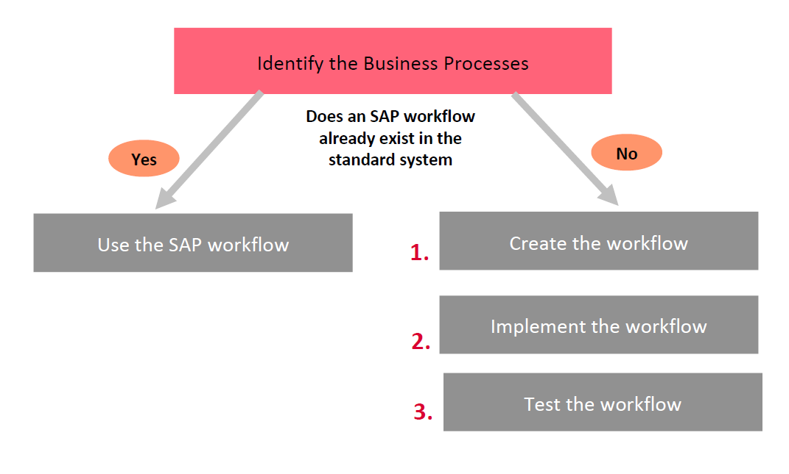
Workflow project Approach

Slide 16
Workflow Components
Workflow
Task
Object
Type

Slide 17
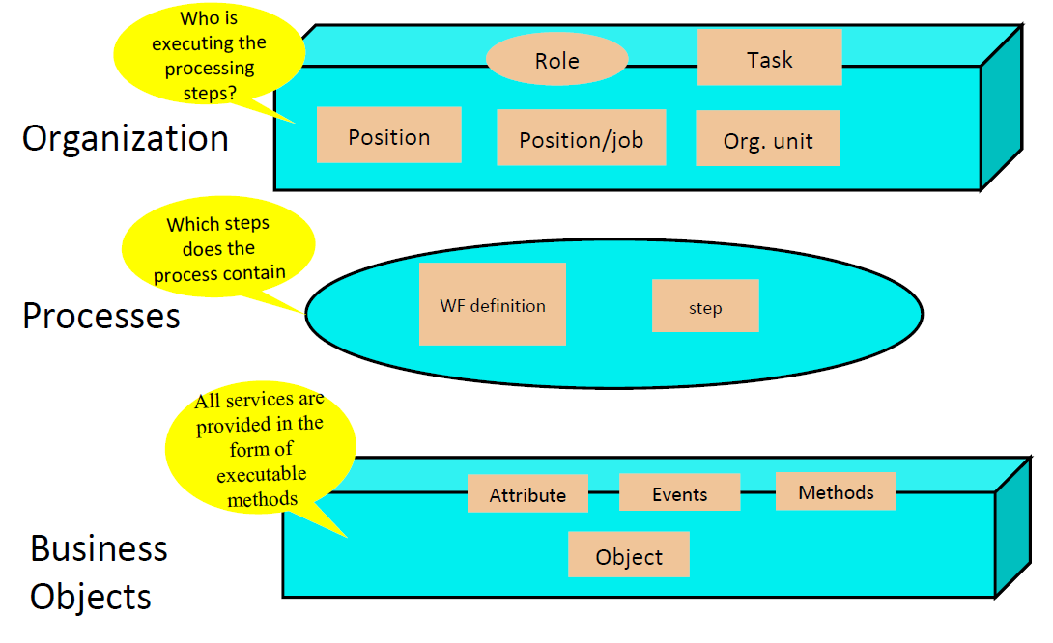
Workflow Architecture

Slide 18
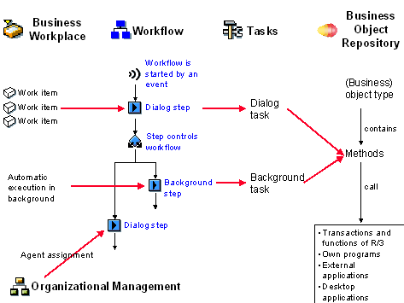

Slide 19
Creation of Workflow or Tasks through T-Code: PFTC

Slide 20
Five Questions for each part of a Business Process and how to map them in Steps/Tasks:

Slide 21
In What Order?: Workflow Definition
Workflow definition controls the calling sequence of each step. Steps like workflow, can also be triggered by events.

Slide 22
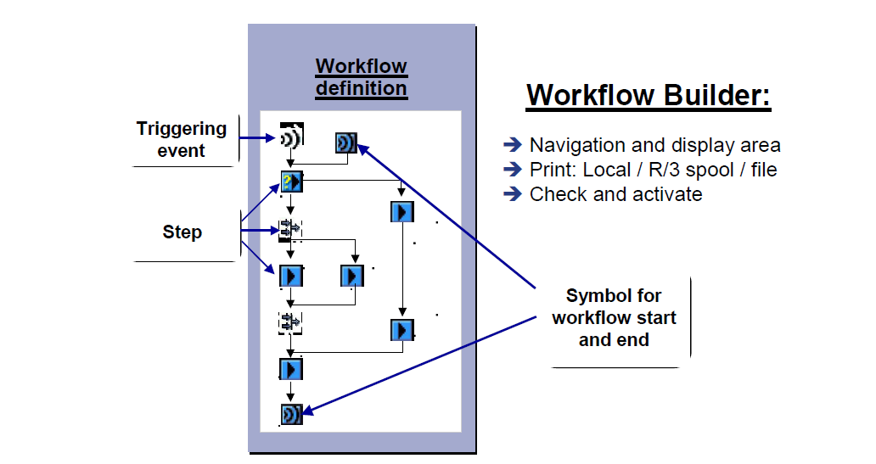
In What Order?: Workflow Builder (SWDD)… How it looks

Slide 23
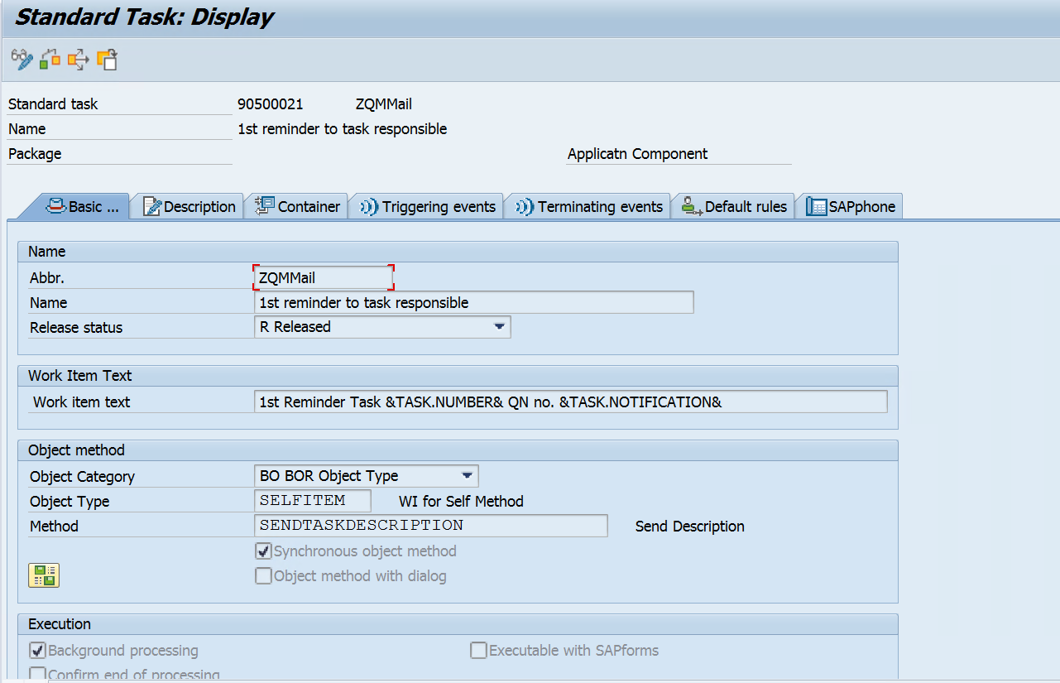
With What Object? What?: T-code: PFTC, Calling Methods within a Task
Attach Object Method here, give Object Category, Object Type and Method Name
Define
•Synch / Asynch
•Dialog / Without Dialog
Define binding between Task
Container and Method here.

Slide 24
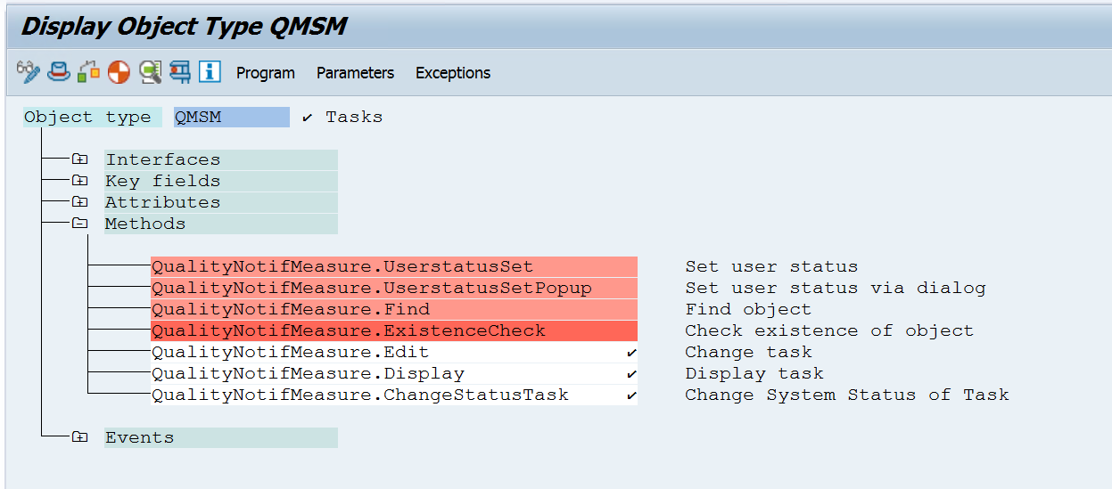
With What Object?: Business Object and its Method

Slide 25
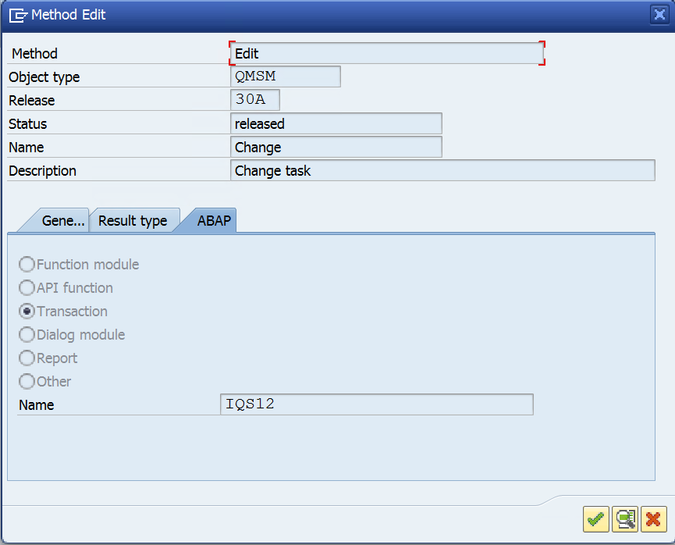
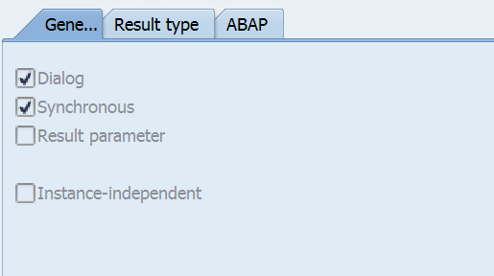
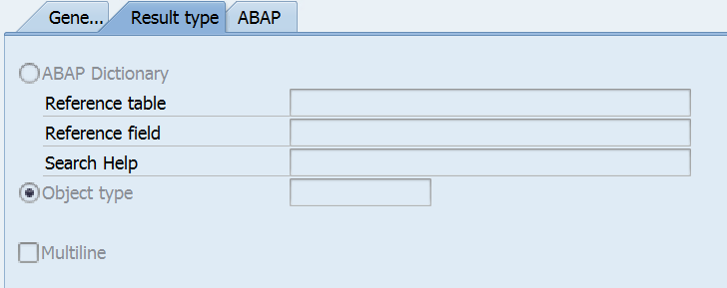
What?: Method Configurations

Slide 26
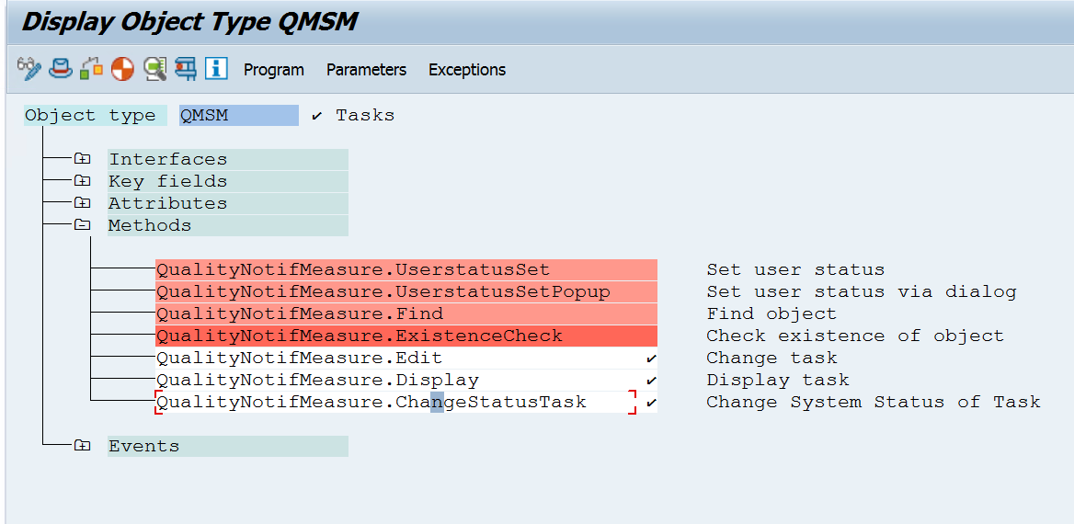
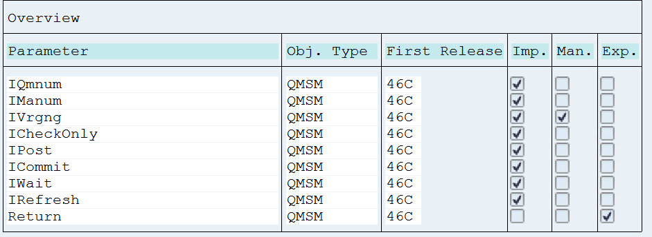
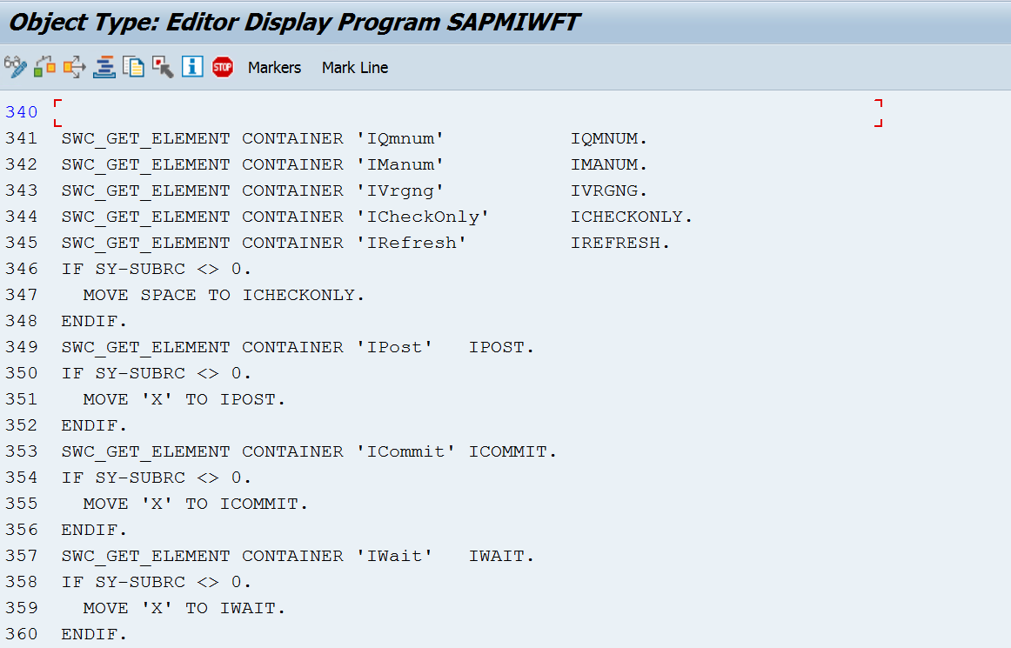
What?: Method Parameters

Slide 27
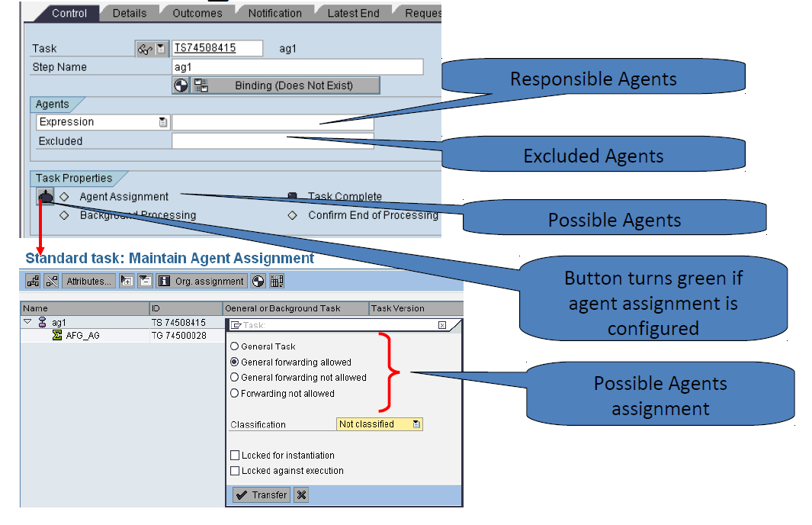
WHO: Agents

Slide 28
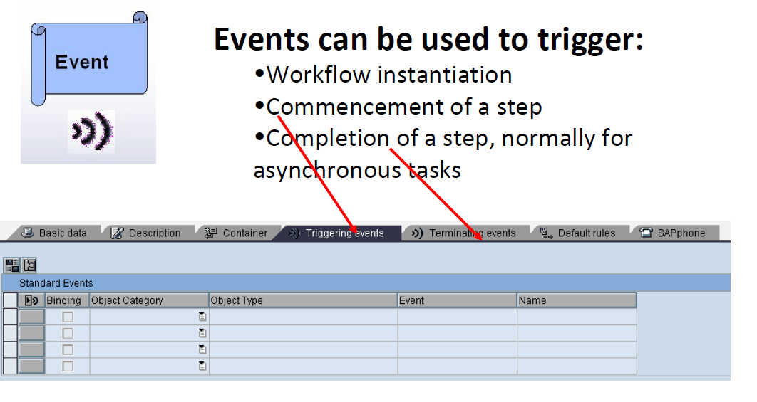
When? T-code: PFTC

Slide 29
When? SWDD-> Double Click on Step…
A Condition, Multiple Condition and User Decision step have more than one outcome and depending on the conditions only one of them is executed.
Outcomes can be labelled for easy understanding.

Slide 30
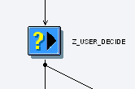
Step Types in Workflow
User Decision
The agent is asked a question and given a pre-defined list of answers
All the options are available in the work item
Each answer is a separate branch in workflow

Slide 31
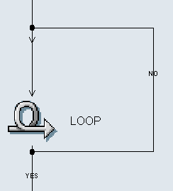
Loop (Until)
Runtime use:
For the purpose of iterative processing of a few steps
based on certain condition.
Condition
Run time use:
- Can be used in a scenario where further course of action depends on the condition being true or false

Slide 32
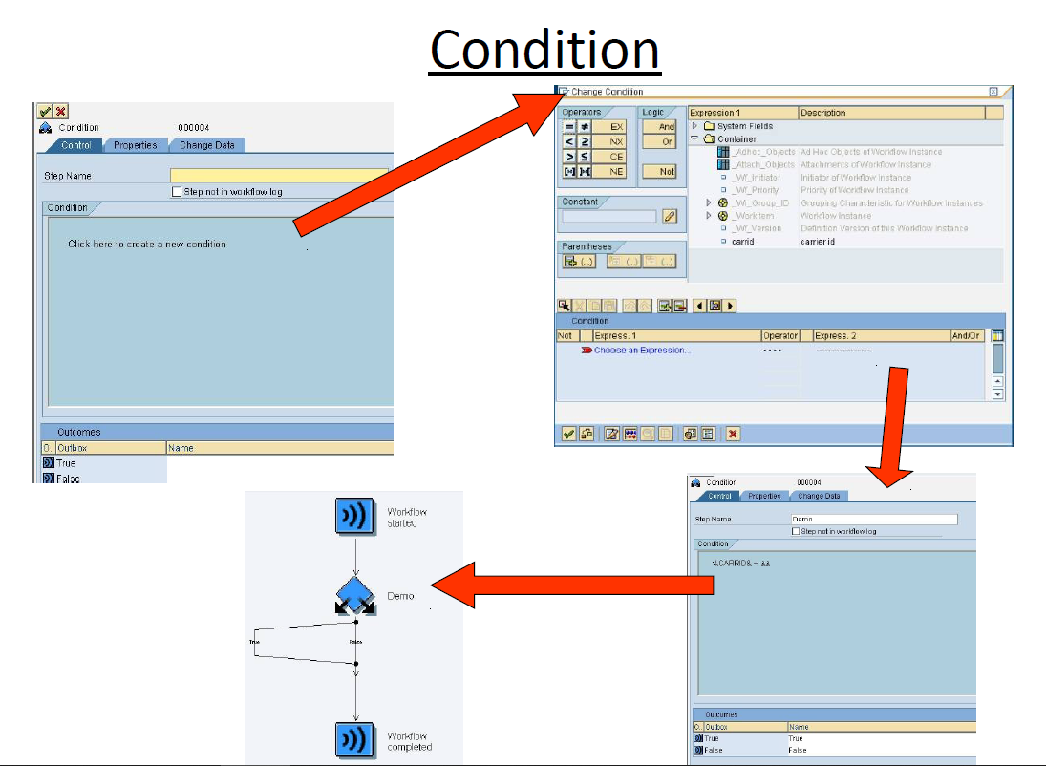

Slide 33
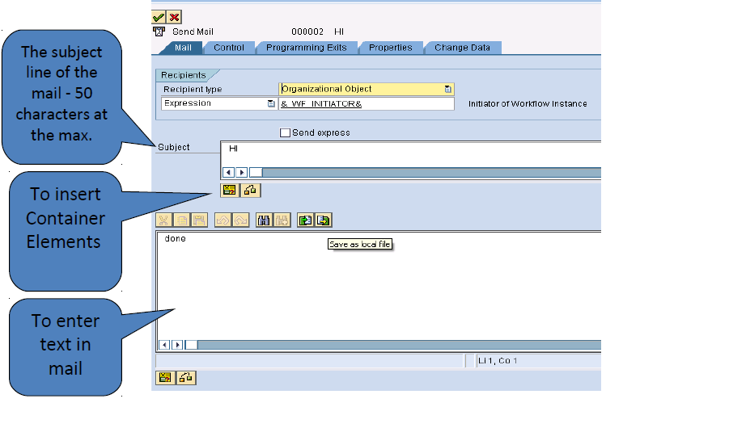
Send Mail:
- The text entered in this step type is sent as an email
- Both external (on the outlook id) and internal mails (SAP mails) can be sent

Slide 34
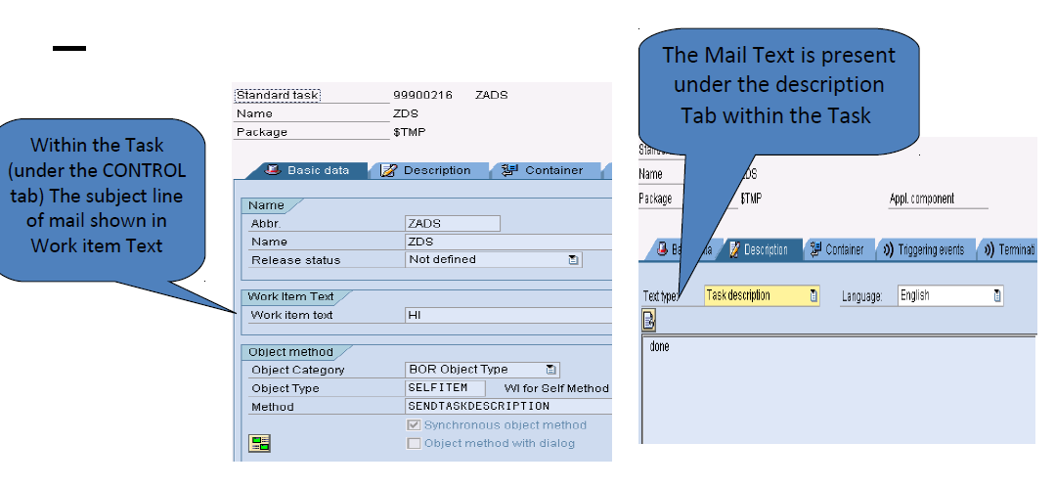

Slide 35
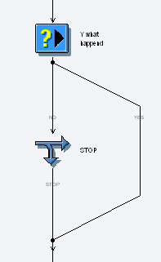
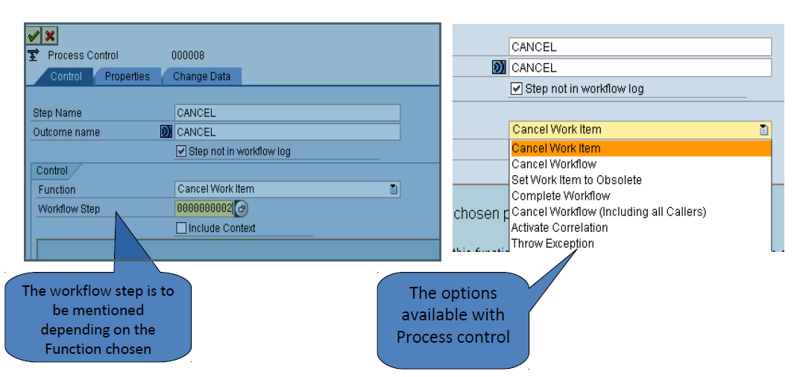
Process Control
This can be used to cancel the execution of a work item or workflow or set a work item to obsolete
It facilitates the alternate steps to be taken in the process obsolete branch

Slide 36
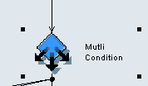
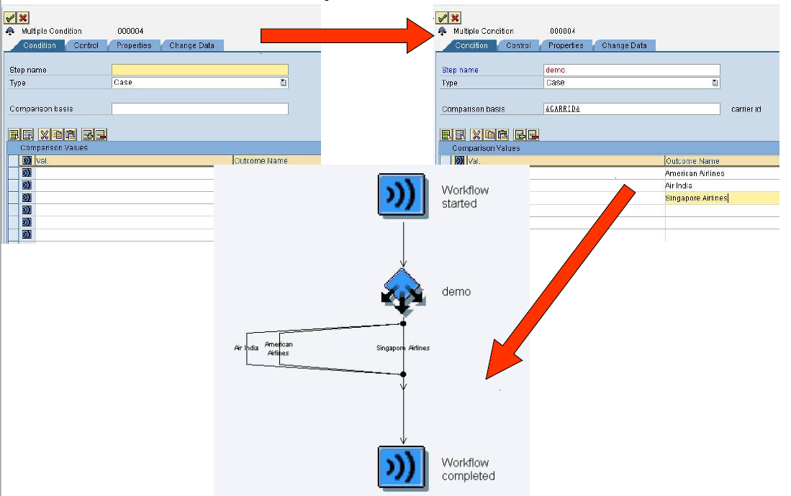
Multiple Condition:
Based on the value of a workflow container element one of the several branches in workflow is processed

Slide 37
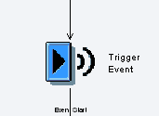
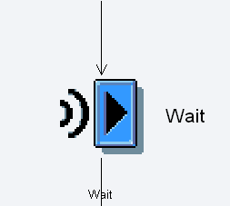
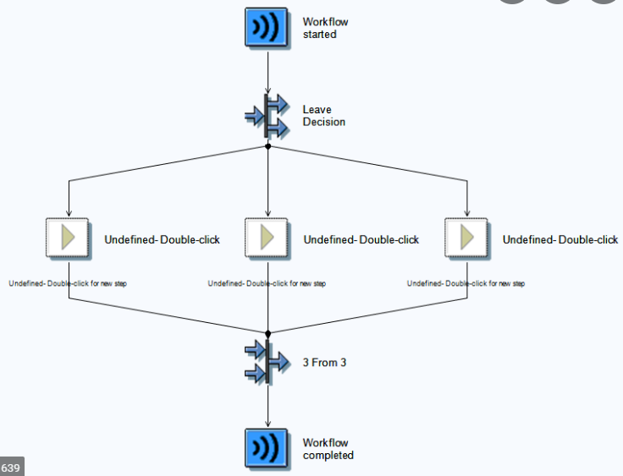
Event Creator :
- To raise an event in the workflow
- Data moves from workflow to event
Wait:
- The system waits for a specific event to be triggered
- The work item is only completed if the expected event occurs
Fork:
Used for the purpose of parallel processing
The user can define the number of parallel processes and how many
should be completed for the Fork to terminate and workflow to
continue
The fork can be terminated by defining a condition too

Slide 38
Container operation:
- For the purpose of performing arithmetic operations or value assignments to workflow container
- Constants and data within workflow can be used
- Multiline operations are allowed
Subworkflow:
- An activity that refers to another workflow rather than a task
Undefined Step:
- These can be used as placeholders during development
- They are ignored at run time

Slide 39
What is a Container
Containers are a common way of holding data throughout the workflow instance’s lifespan.
Containers are used in interface between different parts of the workflow and between the workflow and business applications.

Slide 40
Type of Containers
A workflow container for each workflow and subworkflow
– Only container elements classified as import can be filled when the workflow is started.
A task container for each task
– Import container elements are filled from the workflow container and export container elements are transferred back.
A method container for each method
– Import container elements are filled from task container and export container elements are transferred back.
An event container for each event
– All event containers are export container elements only.
A rule container for each rule
– The import container elements are filled from the workflow container (or task container). The _RULE_RESULT elements is the only export parameter and this is optional.

Slide 41
Binding
Data can be passed from one type to another using binding.
At runtime, the bindings are executed at the appropriate point in the workflow.
For instance, for a synchronous task, the workflow-to-task binding is executed as part of work item creation and the task-to-workflow binding is executed as part of work item completion.

Slide 42
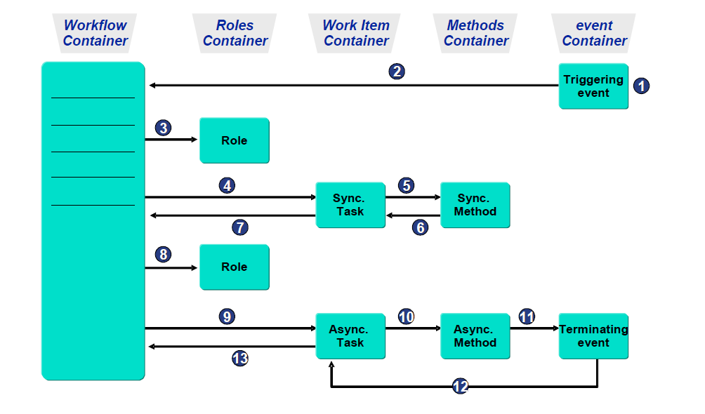
Containers and Bindings

Slide 43
Work Item
Object that represents a task or action in the workflow system at runtime.
Work items are subdivided into a specific work item type according to their assignments. The internal processing procedures are controlled via this work item type. The work item type determines which statuses and transitions are valid.
Depending on the work item type, some of these work items are displayed in a user's work list. Other work items, on the other hand, are only used and processed internally.

Slide 44
Work item Types
A Work item that represents a Work Queue
B Work item for Background step
C Work item that represents a container linkage
D Deadline work item; Notification upon Missed Deadline
E Workitem that waits for an Event (Wait step)
F Workflow (Also subworkflow)
N Notification Item (Obsolete)
P Work item that Represents a Remote Work item (Proxy WI)
R Work item that Represents a Remote Work item (http)
W Dialog work item; Represents a Single-step Task
X Work item that Represents a Block

Slide 45
Work item Status
WAITING: Waiting (Also: Work items in Resubmission)
READY
SELECTED: Reserved
STARTED: In Process
ERROR
COMMITED: Executed (Only If Expl. End Confirmation Is Expected)
COMPLETED
CANCELLED: Logically Deleted
CHECKED: In Preparation
EXCPCAUGHT: Exception caught
EXCPHANDLR: Exception Being Handled

Slide 46
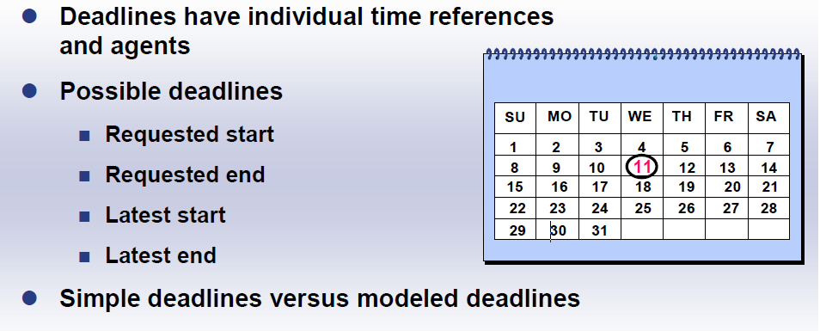
Deadline Monitoring

Slide 47
Deadlines for Workflow Steps
Requested start
– Earliest possible point in time for the commencement of processing
– The requested start is not a monitored deadline in the strict sense. It is when a work item first appears in an agent's inbox.
Requested end
– Requested end deadline for processing a step
Latest start
– Latest start deadline for processing a step
• Latest end
– Deadline by which the processing of a step must be completed.
Note:
All deadlines are monitored using the background job SWWDHEX with job class A. The job calls the report RSWWDHEX.

Slide 48
Events
Events are part of business object, are triggered for changes in the state of the object, which can cause other processes to begin.
Used for Triggering the Workflow
Necessary information needs to be entered on “Triggering Events” tab of the Workflow Builder.
Workflow Engine will automatically generate the binding. You can change it afterwards.
Events can also be defined in Classes. Their behaviour is similar to the events declared in Objects.

Slide 49
Event Creators & Receivers

Slide 50
Event Creation and Triggering
Define Object in Business Object Builder
• Trigger Event:
– Implicitly via generic tools, for example change documents, status management, message control etc
– Explicitly via function module
• SWE_CREATE_EVENT

Slide 51
Monitoring & Analysis
Reporting
– Work Item Monitoring
– Work Item Analysis
– Work load Analysis
Workflow Diagnostic Tool
Reporting
Reporting on Workflow Progress
Work Items by Processing Duration
Work Items with Monitored Deadlines
Work Items per Task
Reporting on Agent Behaviour

Slide 52
Reporting on Workflow Progress
Transaction code: SWI1
This report shows all the work items of the particular task in a particular time period.
This report is also used for monitoring the Workitem

Slide 53
Workflows for Object
Transaction code: SWI6.
This report shows all workflow instances linked to a particular object instance.
Example: Particular Purchase Order

Slide 54
Workflows for Object type
Transaction code SWI14
This report shows all the work items and workflow instances for all object instances of a business object type.
Example: Workflows related to all Purchase Orders

Slide 55
Work Items by Processing Duration
Transaction code: SWI2_DURA
This report gives list of work items based on their processing duration for specified type or for a specified tasks.
This report is also used to analyse a Work item.

Slide 56
Work Items with Monitored Deadlines
Transaction Code: SWI2_DEAD
This report displays work items with their deadline information, if they are set.
For each missed deadline, the current status of the work item is shown.
This report is also used to analyse a Work item.

Slide 57
Work Items per Task
Transaction code: SWI2_FREQ
This report shows the number of work items created in the specified period.
This report is also used to analyse a Work item.

Slide 58
Reporting on Agent Behaviour
Transaction Code: SWI5
With the help of this report , you can monitor how quickly agent act on their work items
This report is useful for assessing workload over particular time period.
This report is useful for reporting on the type and frequency of tasks being sent to an agent.
This report is also used to analyse a Work load.

Slide 59
Workflow Diagnostic Tool
Transaction Code: SWUD
A primary diagnostic tool.
Analyse workflow definition.
Following are the options available:
Verify workflow customizing
Perform Workflow Customizing
Problem: Task does not start
To track down the exact cause of an error
Problem: Workflow is hanging
Choose this option when workflow starts but stops before completion, due to some error.
Test Environment
Choose this option when you want to access the complete suite of test tools from one place.
This option will also display all the components

Slide 60
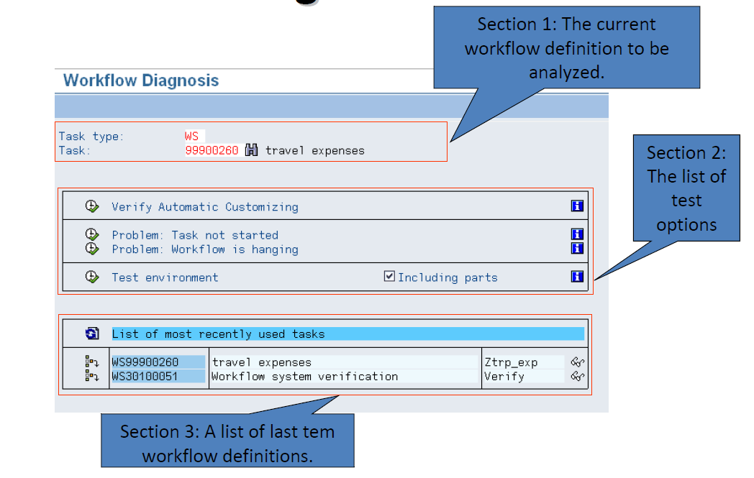

Slide 61
Working with the Workflow Log
At runtime, a workflow has its own work item (type F) that represents the workflow instance.
The workflow log formats all the information created during the execution of the business process
Standard view
Intended for agents and process owners who want to get an overview of the steps processed.
Technical view
Intended for developers and workflow administrator

Slide 62
Standard View
Workflow Chronicle (What processed when?
Workflow Agents (Who Processed what?)
Workflow Objects (What was processed?)

Slide 63
Workflow Chronicle
The tab page Workflow Chronicle shows a hierarchical display of all the steps in the workflow. If workflow has a subworkflow structure, the subworkflow are also displayed.

Slide 64
Workflow Agents
The Tab page Workflow Agents shows the agents involved in the workflow.
Following options are displayed for each agent:
• What action was carried out in what step
• When this action was carried out
• The objects involved

Slide 65
Workflow Objects
The tab page Workflow Objects lists the objects related to the workflow. This view shows what objects were created and processed.

Slide 66
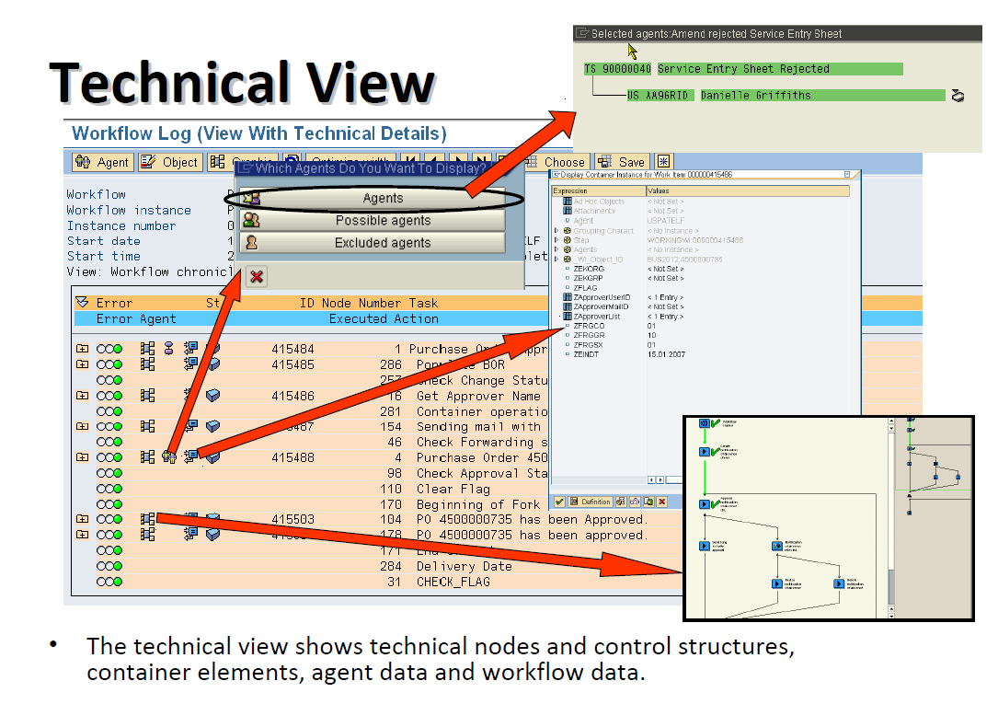

Slide 67
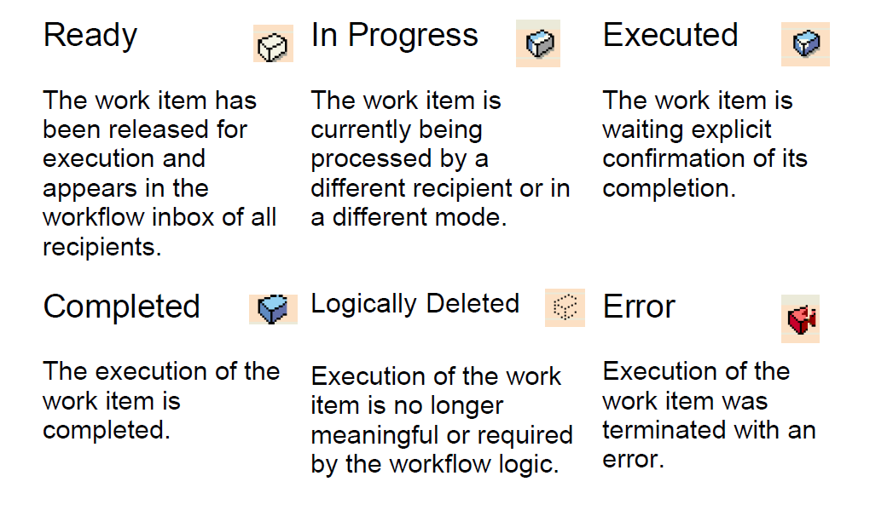
Workflow Status

Slide 68
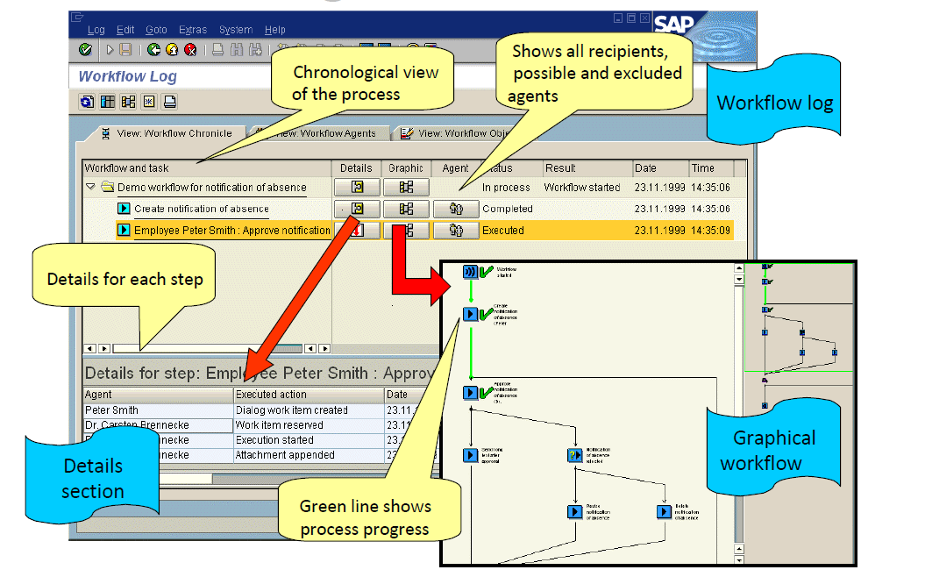
Workflow Log

Slide 69
List of Transaction Code
SWO1: Business Object Builder
SWDD: Workflow Builder
SWUD: Workflow Diagnosis
SBWP: Business Workplace
SWU3: Automatic Workflow Customizing
PFTC: Maintain Task
SWO3: Business Object Repository Browser
SWE2: Event Linkage
SWI1: Report for Work items
SWI2_FREQ: Work Items per Task
SWI2_DEAD: Work Items with monitored Deadlines

Slide 70
Thank you ☺

